Slide 1
Binary Heap
Mr. Jenkins favorite data structure because it so elegant

Slide 2
Binary Heap
earlier we learned about a first-in first-out structure called a queue (waiting in line). An important variation of this idea is the priority queue.
Imagine a night club that is really popular. The doorman of the club has a system for everyone in line, when they arrive at the club to get in line, they pay a dollar amount to the doorman, he then puts them in line according to the size of the amount. The higher the amount the closer to the front of the line they get placed.

Slide 3

450
400
190
40
500
150
20
10
100

Slide 4
Details of priority que
The front of the queue has the highest priority
The back of the priority queue has the lowest priority
the queue items are arranged so that for any item, all the items in front of that item are equal or higher in priority and all items in the back of that item are lower or equal priority.
Any new item will be inserted into a position that maintains the order of the queue

Slide 5
Our implementation of a priority queue
you can implement this using a a list and sorting functions, but that would be O(n log n) and we can do better.
The classic way to implement a priority queue is a data structure called a binary heap.
A binary heap will allow us to enqueue and dequeue items both with O( log n) performance which is very fast.

Slide 6
binary heap structure
When we diagram a binary heap it looks a lot like a tree with nodes that have up to two children each, in fact it is a binary tree.
But we will implement it only using a single list.
There are two kinds of binary heap:
max heap: priority is given to the biggest value
min heap: priority is give to the smallest value

Slide 7
We will only be doing a min heap: BinaryHeap ADT
BinaryHeap() – create a empty min heap
insert(item) – insert an item onto heap
findMin() – search for the min value and return it, but do not remove it
delMin() – remove and return the minimum value
isEmpty() – return true if heap is empty, false otherwise
buildHeap(list) – build a heap from a list of values

Slide 8
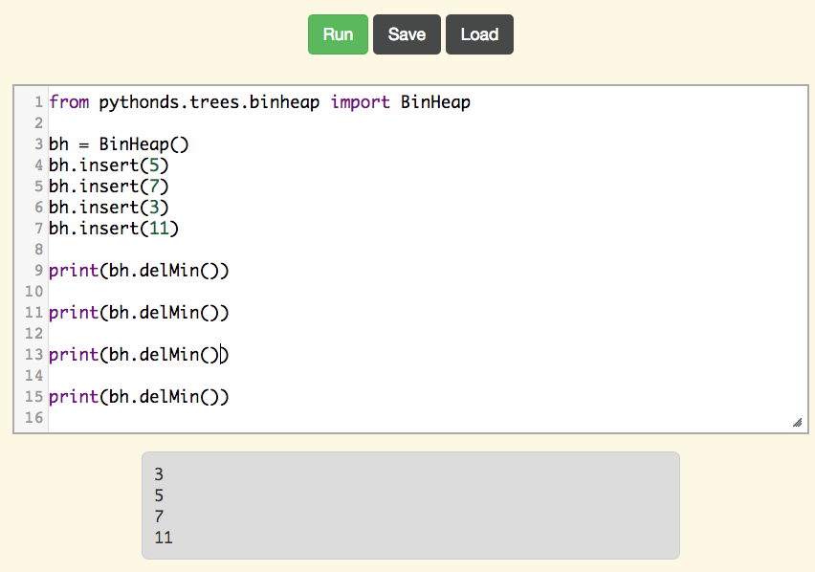

Slide 9
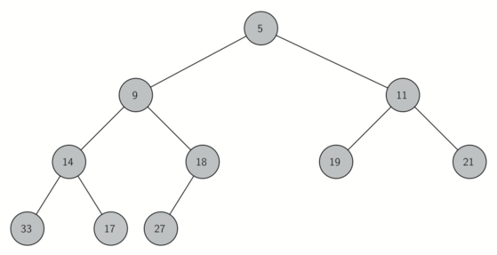
To make our binary tree efficient we are going to make the tree as balanced as possible. Balanced trees try to have as equal a levels for both the left and right sub trees.
We are going to do this with a "Complete binary tree"

Slide 10
A "Complete binary tree" means that every level is FULL except the last level, and it will ONLY be missing nodes on the right.

Slide 11
level | Number of nodes
0 | 2⁰ = 1
1 | 2¹ = 2
2 | 2² = 4
n | 2^{n}
A "Complete binary tree" has a fixed number of nodes on each full level:
Each level down has twice as many nodes as the level above.

Slide 12
We can put this all into a list:
level 0
level 1
level 2
level 3
unused
 | 5 | 9 | 11 | 14 | 18 | 19 | 21 | 33 | 17 | 27
0 | 1 | 2 | 3 | 4 | 5 | 6 | 7 | 8 | 9 | 10 | 11 | 12 | 13 | 14 | 15
1
2
3
4
6
5
7
8
9
10
11
12
13
14
15

Slide 13
level 0
level 1
level 2
level 3
unused
0 | 5 | 9 | 11 | 14 | 18 | 19 | 21 | 33 | 17 | 27
0 | 1 | 2 | 3 | 4 | 5 | 6 | 7 | 8 | 9 | 10
left child of node p is 2p
right child of node p is 2p + 1
the parent of child node c is c/2 (using integer division)
1
2
3
4
5
6
7
8
9
10
11
12
13
14
15

Slide 14
level 0
level 1
level 2
level 3
unused
0 | 5 | 9 | 11 | 14 | 18 | 19 | 21 | 33 | 17 | 27
0 | 1 | 2 | 3 | 4 | 5 | 6 | 7 | 8 | 9 | 10
class BinHeap:
def __init__(self):
self.heapList = [0]
self.currentSize = 0
Here is the code to construct our binary heap.
We start with a list of just one element that is not used and keep track of the total size of the heap with another instance variable
Now we can insert new items by first just appending them to the heap, but we need to talk about how to keep the priorities all arranged.

Slide 15
The Heap Order Property
We have to maintain a special order to be able to quickly with O( log n) time always remove the smallest item of the heap.
We will rely on the heap always meeting the "Heap order property"::
In a heap, for every node x with parent p, the key in p is smaller than or equal to the key in x. (or for every parent there are no children that are smaller then them)

Slide 16
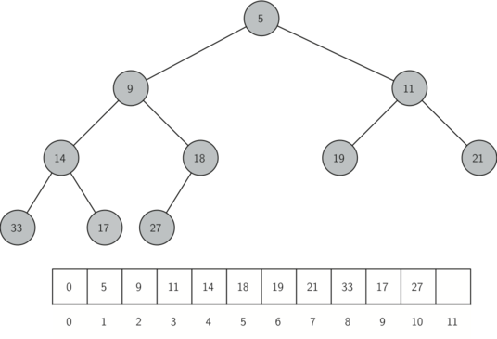
A compete binary tree that follows the heap order property

Slide 17
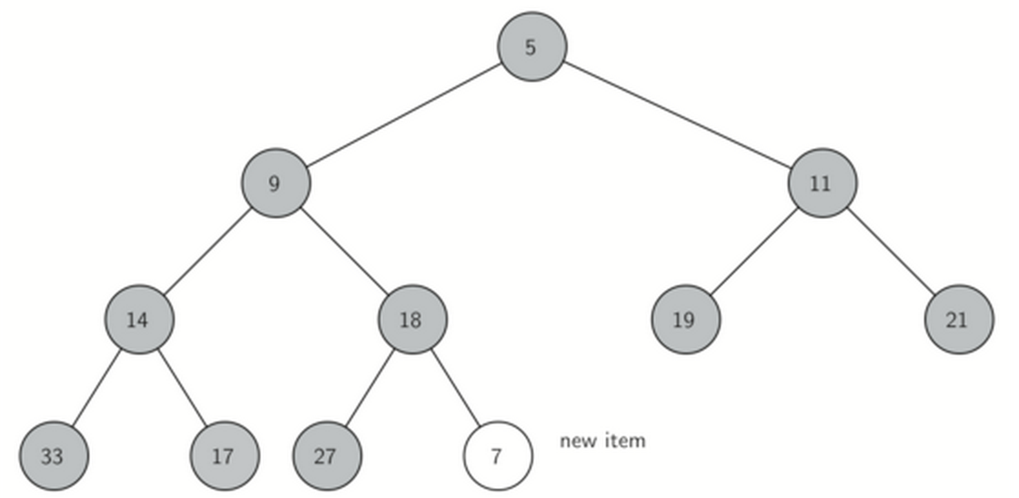
insert(item): we insert at end:

Slide 18
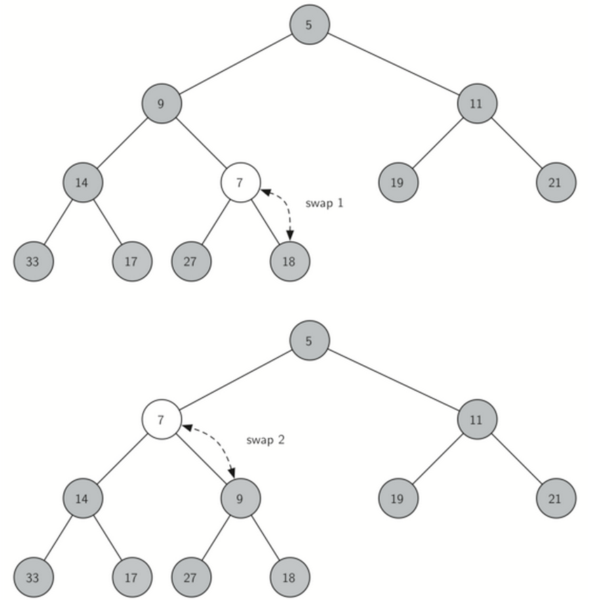
we can fix this by swapping it with each parent that it is smaller than
we call this
percolating the item up

Slide 19
code for percUp and insert
def percUp(self,i):
while i // 2 > 0: # while has a parent
if self.heapList[i] < self.heapList[i // 2]: # if out of order
tmp = self.heapList[i // 2]
self.heapList[i // 2] = self.heapList[i]
self.heapList[i] = tmp
i = i // 2 # loop with new position
def insert(self,k):
self.heapList.append(k) # insert at end of list
self.currentSize = self.currentSize + 1 # update size
self.percUp(self.currentSize) # adjust to be in heap order
Remember | is formula
i's left child is | 2 * i
i's right child is | 2 * i + 1
i's parent is | i // 2

Slide 20
Now for removing the smallest
The smallest is the top root node value!
but once we remove it, we have a hole in our "complete binary tree", so it is not complete anymore
We need to fill the hole and also finish with the entire heap meeting the heap order property.

Slide 21
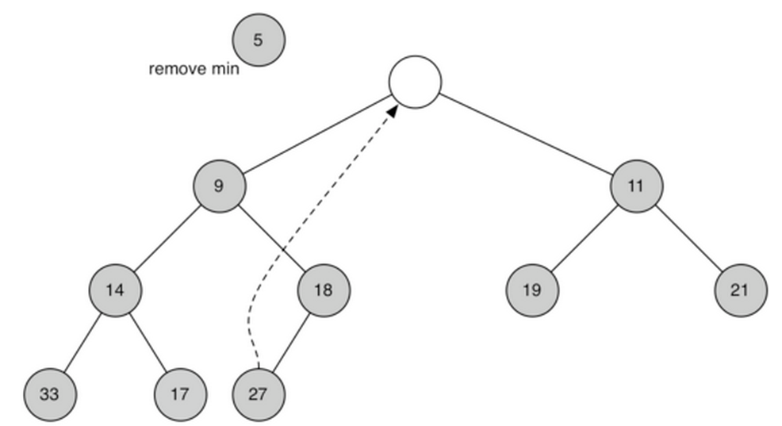
To start, since removing the 5 made the heap have 1 less item, we will move the last item into the top position ( move 27 to the top root value)

Slide 22
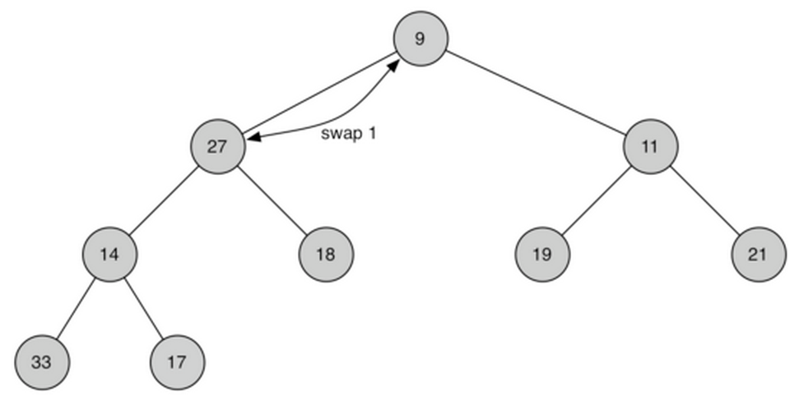
we will swap the 27 with the smallest child as long as the 27 has smaller children

Slide 23
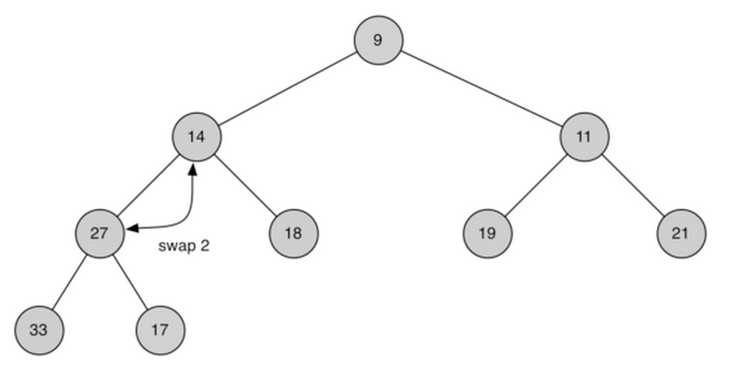
we will swap the 27 with the smallest child as long as the 27 has smaller children

Slide 24
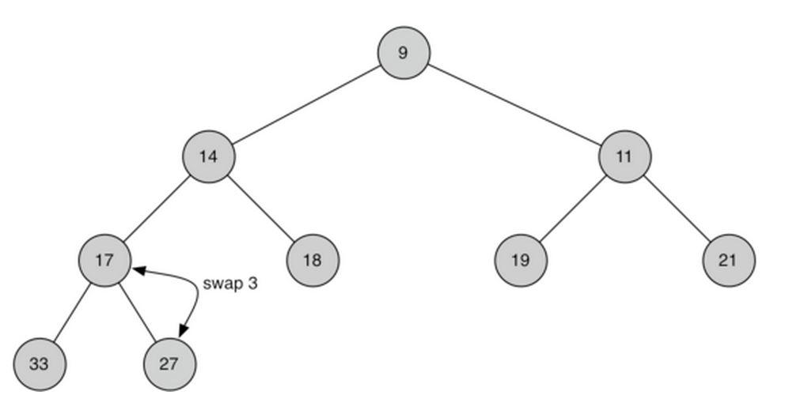
this is called percolating down

Slide 25
the code to delMin() and percDown:
def percDown(self,i):
while (i * 2) <= self.currentSize:
mc = self.minChild(i)
if self.heapList[i] > self.heapList[mc]:
tmp = self.heapList[i]
self.heapList[i] = self.heapList[mc]
self.heapList[mc] = tmp
i = mc
def minChild(self,i):
if i * 2 + 1 > self.currentSize:
return i * 2
else:
if self.heapList[i*2] < self.heapList[i*2+1]:
return i * 2
else:
return i * 2 + 1
Remember | is formula
i's left child is | 2 * i
i's right child is | 2 * i + 1
i's parent is | i // 2
def delMin(self):
retval = self.heapList[1]
self.heapList[1] =
self.heapList[self.currentSize]
self.currentSize = self.currentSize - 1
self.heapList.pop()
self.percDown(1)
return retval

Slide 26
A trick to build a min heap from a list in O(n) time
I would be easy to create a min heap from a list by just inserting each element in O(n log n) time.
but if you read the last part of this section you can just use the original list and reorder it to make a heap in O(n) time
check out this section of the book.

Slide 27
A last note
Note that you can sort a list by combining building a heap form a list and then use the delMin() to extract the items into a new list in O(n log n) time, which is as good as a sort method gets.

